Slide 1
JOINS, SUBQUERIES, CTEs & WINDOW FUNCTIONS
Ian Mbaya

Slide 2
TYPES OF JOINS
INNER JOINS – returns records that have matching values in both tables.
LEFT JOIN – returns all rows from the left table and the matched from the right. NULLs are returned if no match exists.
RIGHT JOIN – opposite of the left join
FULL JOIN – returns all rows from the left and right table whether there is a match not.
CROSS JOIN/CARTESIAN PRODUCT – Each row in the left is combined with all the rows from the second table.
SELF JOIN – join a table with itself.
Notes:
Full Join – comparison
Cartesian Joins – Find all possible combinations
Self-join - Compares rows within the same table, i.e. when identifying a hierarchy within the data

Slide 3
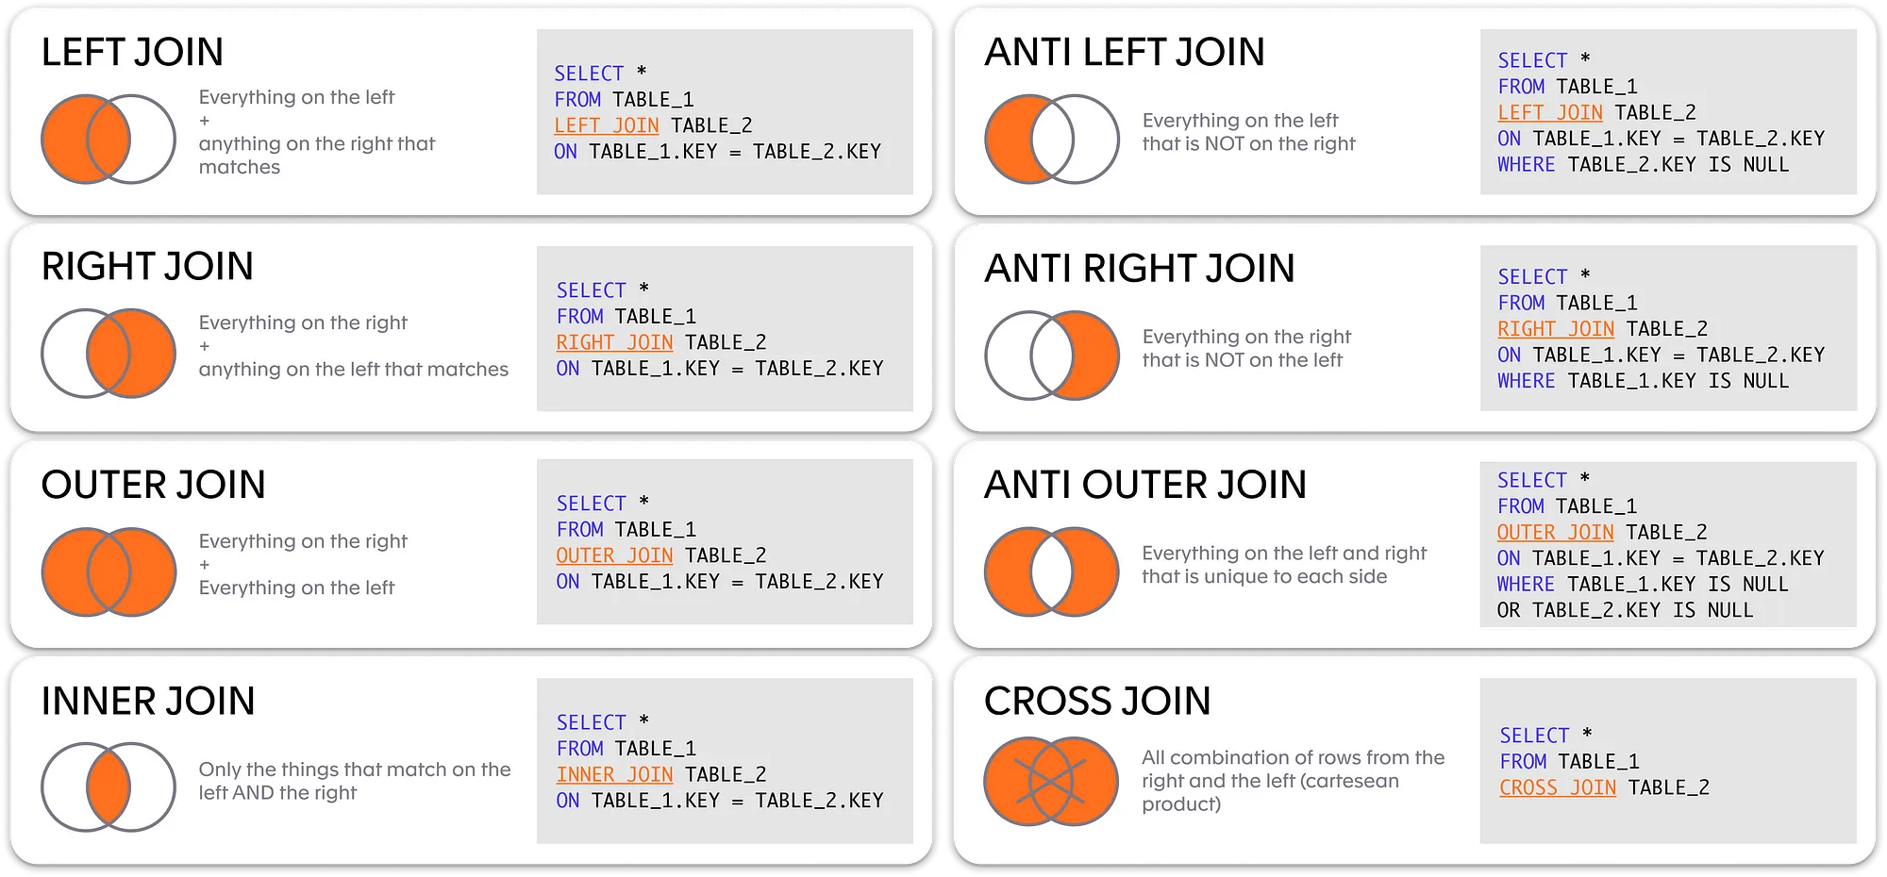

Slide 4
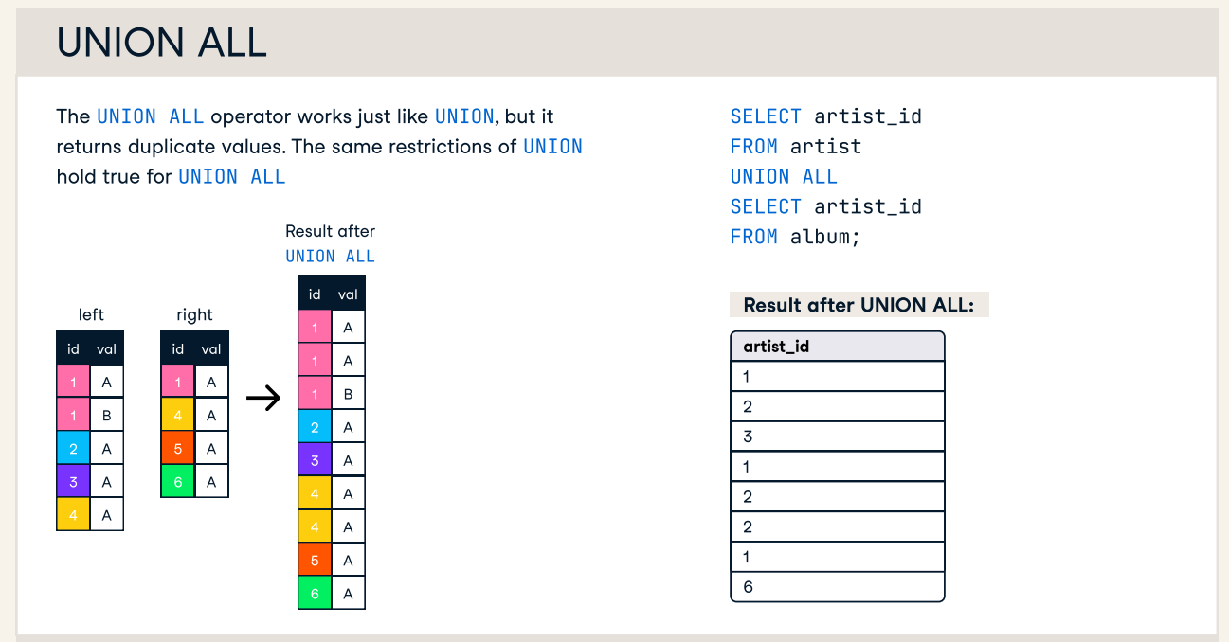
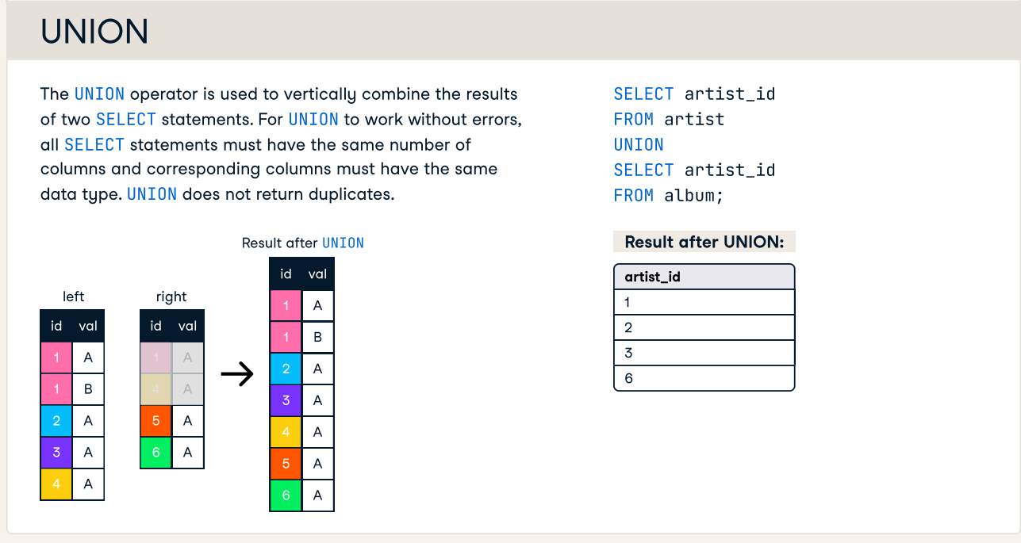

Slide 5
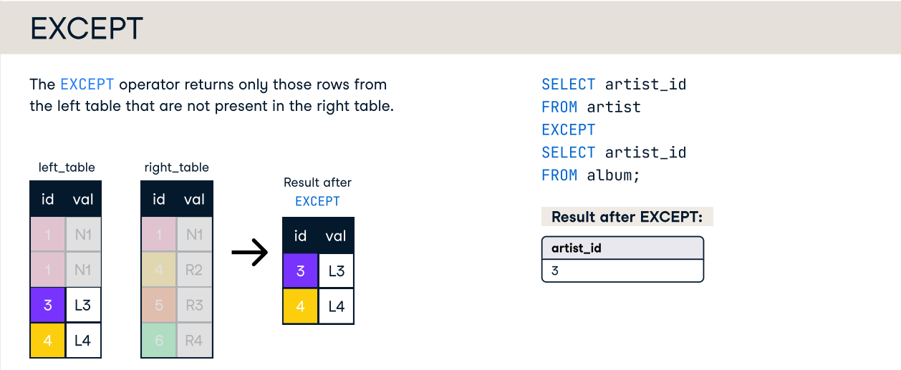
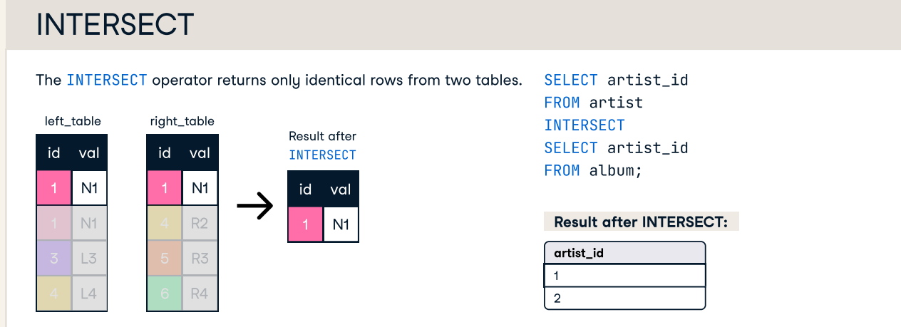

Slide 6
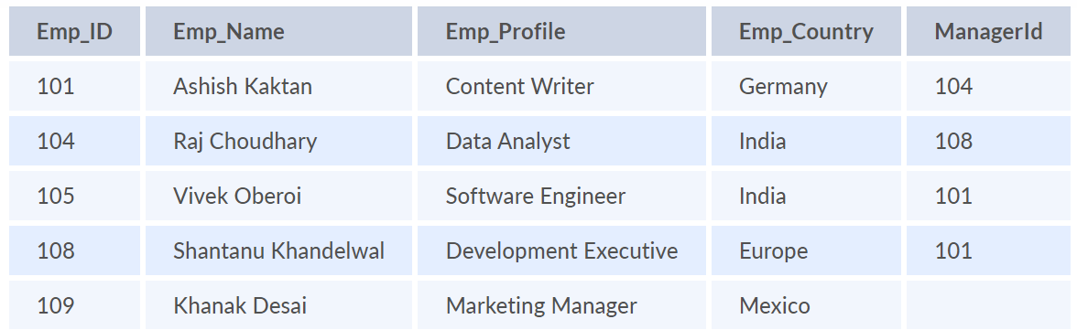
Practice 1
What type of join do we use in this case?
How do we write it?

Slide 7
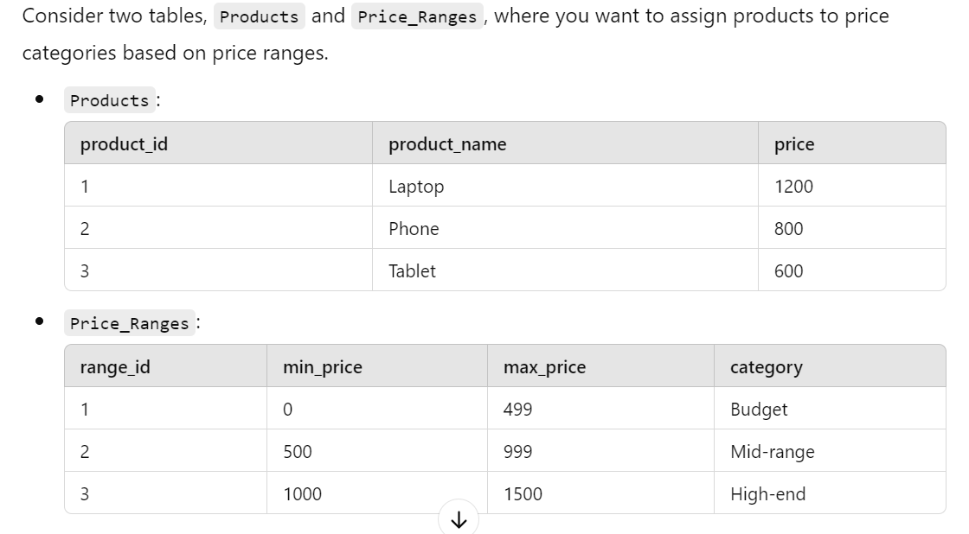
Practice 2
Important things to know
Natural JOINS
EQUI JOINS vs NON-EQUI JOINS
Any other thing about joins?

Slide 8
SUBQUERIES
*A query that is nested within another query.
Subqueries can be used within SELECT, FROM, WHERE, DELETE, HAVING, INSERT, and UPDATE statements there are used to:
Add a new column to the main query result.
Creating a filter.
Creating a consolidated source for selecting data.
Check for existence.
Compare related data.
Simplifying complex queries.
Avoiding repetition

Slide 9
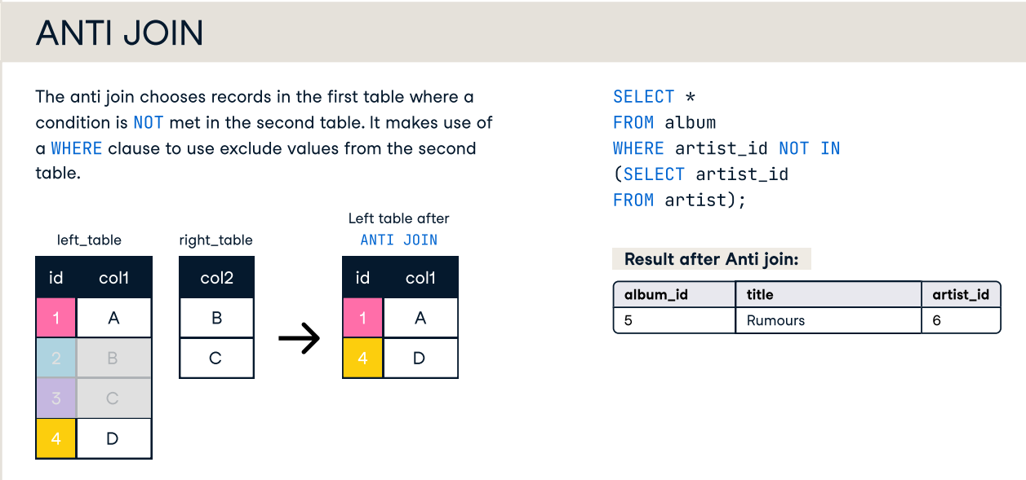
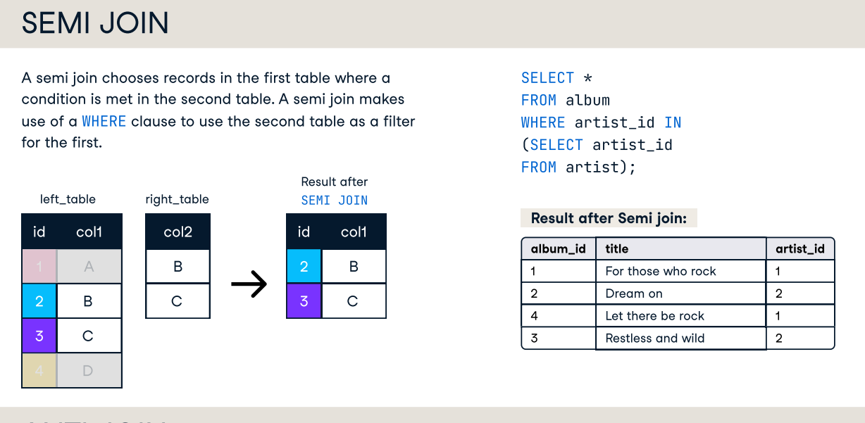

Slide 10
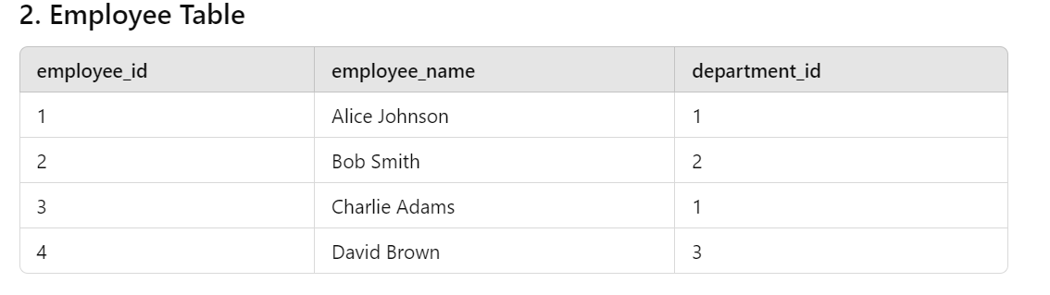
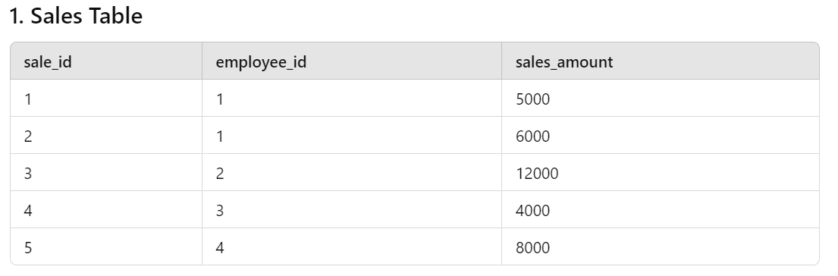
Practice 3 – Find Employees who sold > 10k

Slide 11
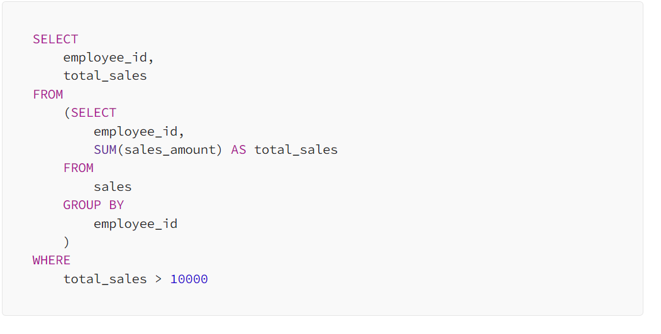
Another Example of subquery

Slide 12
Common Table Expressions
Temporary result set, used to simplify complex queries.
Defined using WITH before the main query.
Enhances readability and reusability.
Recursive CTEs handle hierarchical data.

Slide 13
Practice 4
Find Employees who sold over 10k using CTE?

Slide 14
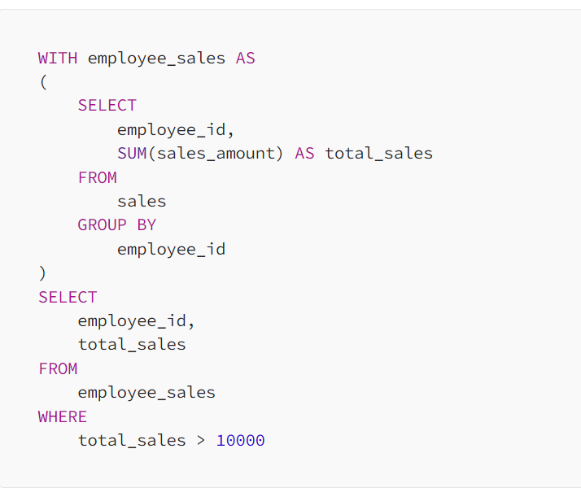
CTE - Example

Slide 15
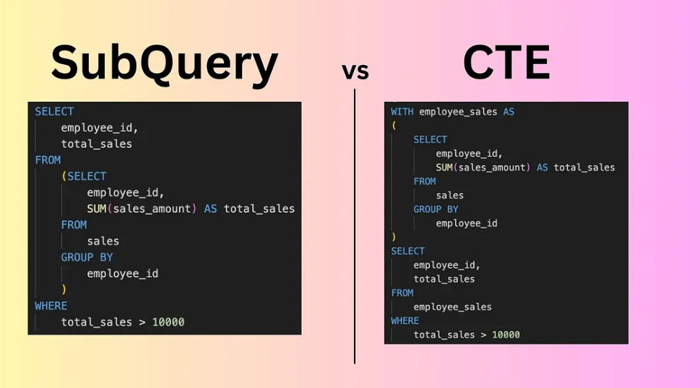

Slide 16
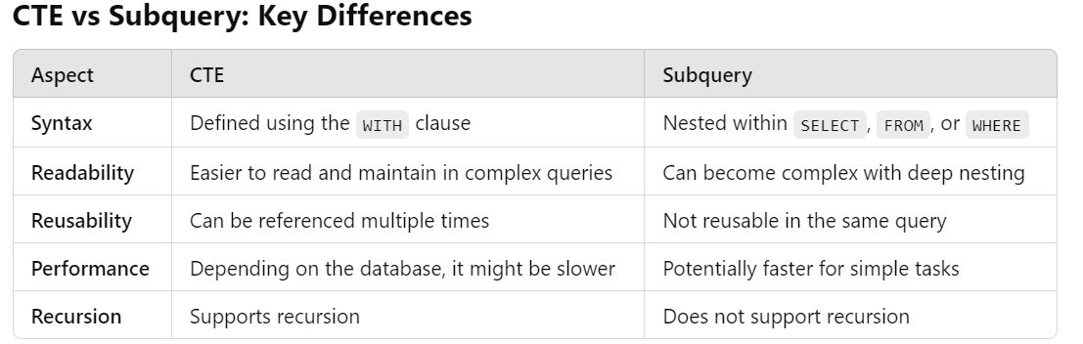

Slide 17

Window functions?
SQL features that allow you to perform calculations across a set of rows that are related to the current row, without collapsing the result set into a single output row.
Window functions compute their result based on a sliding window frame, a set of rows that are somehow related to the current row.

Slide 18
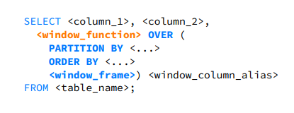
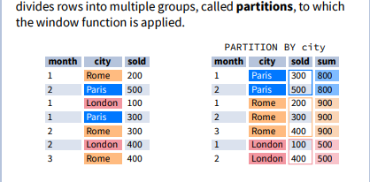
Windows Function - Syntax
You must define a window_function and OVER () for the function to be applied across columns.
PARTITION BY, ORDERBY and window frame are all optional.
<window_frame> defines bounds
Notes:
UNBOUNDED PRECEDING Includes all rows before the current row.
n PRECEDING Includes rows within n rows before the current row.
CURRENT ROW Refers only to the current row.
n FOLLOWING Includes rows within n rows after the current row.
UNBOUNDED FOLLOWING -Includes all rows after the current row.
These bounds define how much data is included in calculations for each row within a window frame, allowing for flexibility in aggregations like running totals or moving averages.

Slide 19
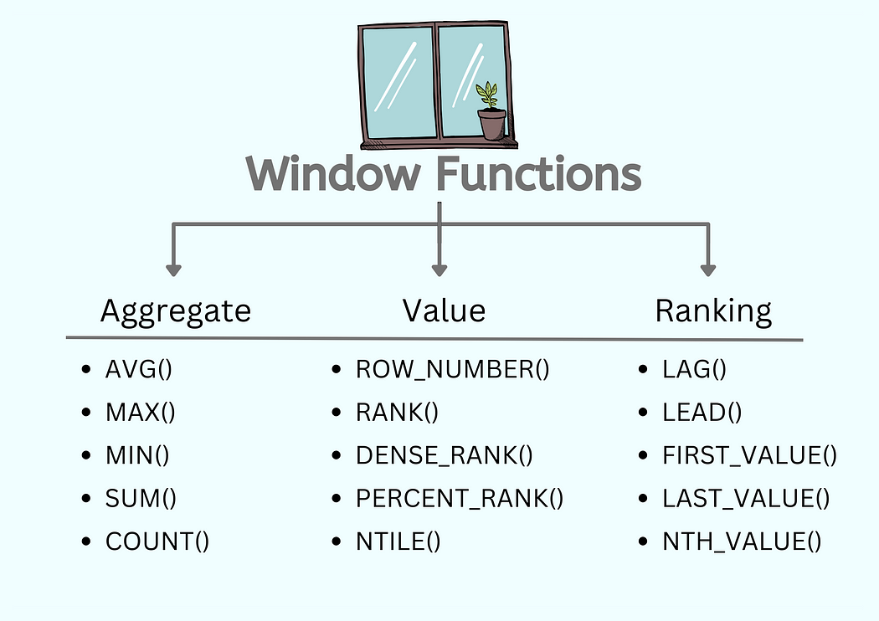

Slide 20
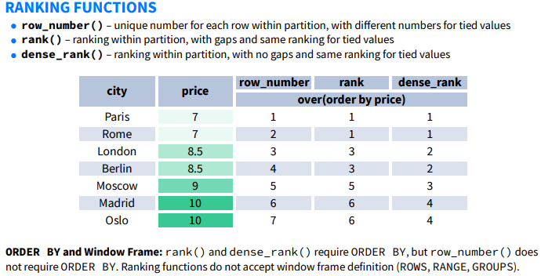

Slide 21
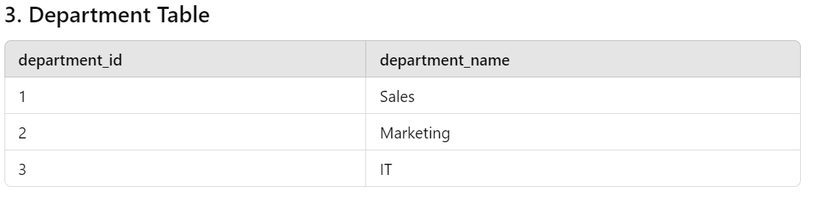
Practice 5
Find all employee total sales
Find ranked total sales for each department
Find previous and next employee sales

